Slide 1



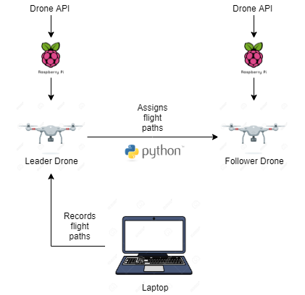
Background
System Diagram
Approach
In our project, we focus on having an autonomous follower drone to follow a primary leader drone. The project would help improve military technology by exploring ways to allow a single drone to communicate or control multiple autonomous drones.
Assemble Raspberry Pis on both drones
Integrate drone API with Raspberry Pis
Develop a program that will record GPS location of drones.
Materials
Milestones
Drones
Raspberry Pi
GPS Tracker
Telemetry Module
Hack drone API library
Control drones via computer
Leader drone sends GPS commands to follower drone

Slide 2
Background
System Diagram
Approach
In our project, we focus on having an autonomous follower drone to follow a primary leader drone. The project would help improve military technology by exploring ways to allow a single drone to communicate or control multiple autonomous drones.
Assemble Raspberry Pis on both drones
Integrate drone API with Raspberry Pis
Develop a program that will record GPS location of drones.
Reference
Bouman, Paul, et al. “Dynamic Programming Approaches for the Traveling Salesman Problem with Drone.” Networks, vol. 72, no. 4, 2018, pp. 528–542.
Mottola, Luca, et al. “Team-Level Programming of Drone Sensor Networks.” Proceedings of the 12th ACM Conference on Embedded Network Sensor Systems - SenSys '14, 2014.
Milestones
Materials
Hack drone API library
Control drones via computer
Leader drone sends GPS commands to follower drone
Drones
Raspberry Pi
GPS Tracker
Telemetry Module

